Slide 1



DIGITAL ASSISTANT HAKO INNOVATE FOR BETTER CUSTOMER SERVICE
Group: 3M2S

Slide 2
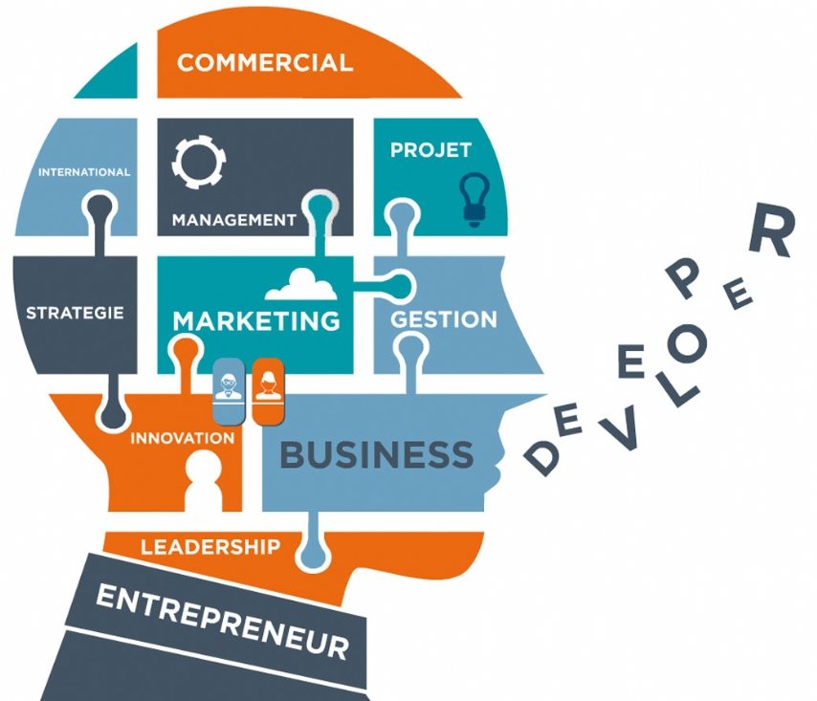
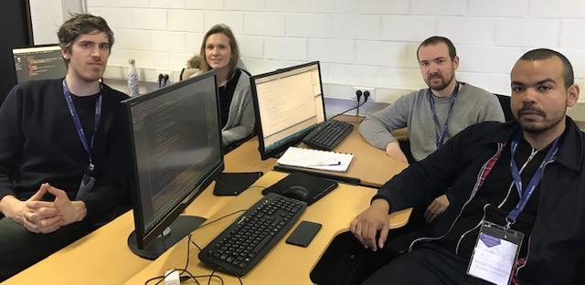
TEAM: 3M2S
Frontend developers: Martin & Sophie,
Backend developers: Mathieu & Simon
Business profile: Martina(photographer)

Slide 3




89%
It takes months to find a customer & only seconds to lose one!
Unhappy client share 2x more his bad experience
50%
Notes:
It makes one month to make a customer and second to loose.

Slide 4
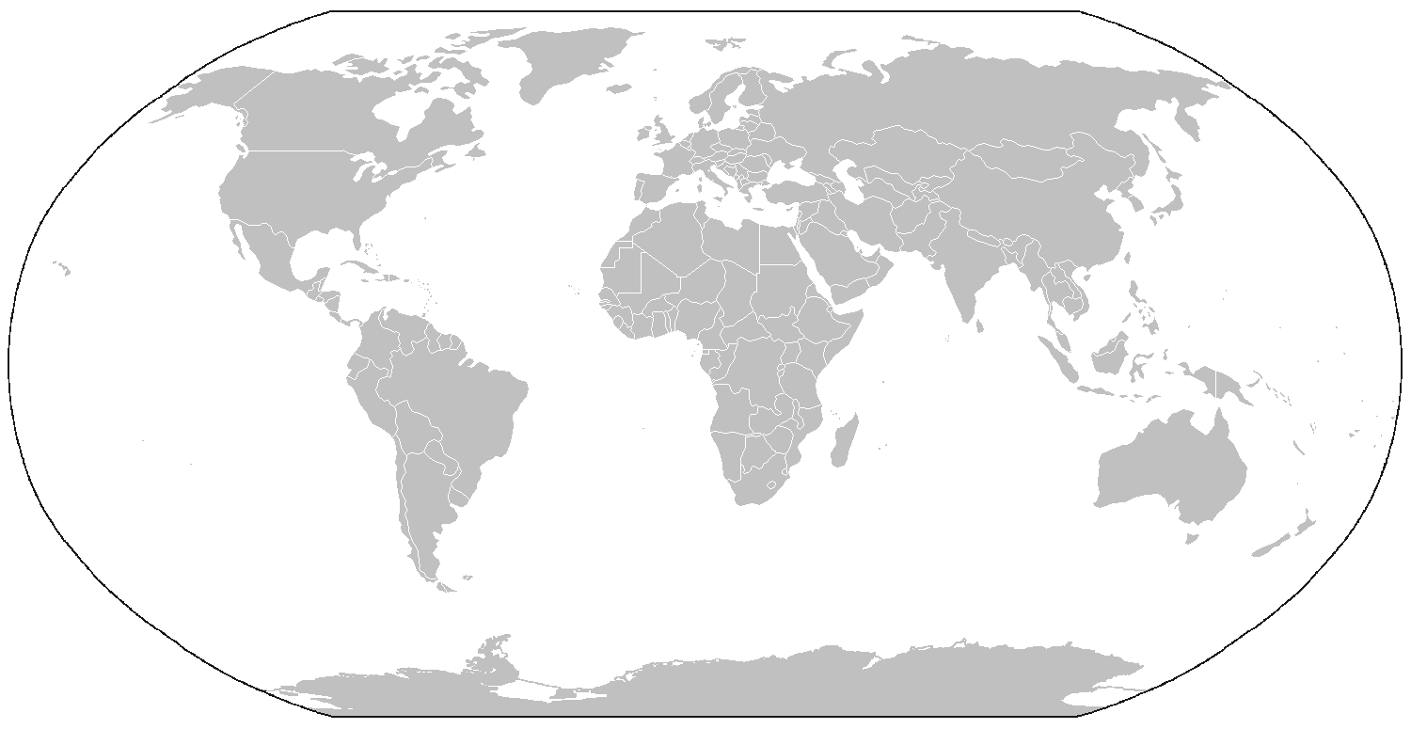

World Wide Hakobio Clients
Beckman Coulter (USA)
Catapult cell therapy (UK)
Pall Biotech (Africa & Middle East, Asia Pac)
IMT Groupe (France) Merck Millipore (World wide)
Sanofi Pasteur (France)
Servier (France)
Cellectis (France)
Bio-Rad (France)
Kuhner shaker (Switzerland/Europe)
= MORE 1000 USERS

Slide 5


Customer
Company
Consumer: user Hakobio product
Marketing has to address users
Design, utilities are focus on Hakobio users & agents needs

Slide 6
Our Idea
Who is HAKO? 箱 is smart digital assistant who bring harmony and change chaos into order.
Hakobio users purchase HAKO
Visual conversation with user
Communication between HAKO - users and Hakobia agents
Customized answers (preselected field)

Slide 7
Value proposition
Messaging Option:
Communication service 24/7/365
Immediate answer
90% correct answer (based on Chatbot’s study)
Traceability of conversation
Increase customer satisfaction
Quality & detail of responses
Personalized answer
Use it in:
Customer service (questions)
Future: Sales (proposition of new products)
Innovate customer service:
Gain client faithfulness
Notes:
les bots seront capables de détecter toujours mieux vos émotions, notamment sur base du choix des mots par l'utilisateur, ce qui leur permettra d'adapter la conversation.

Slide 8
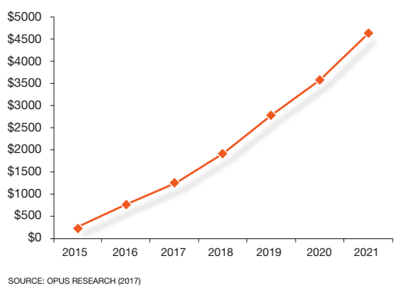
Spending on Enterprise Intelligent Assistants
Notes:
In this report, Opus Research presents a comprehensive assessment of the current Intelligent Assistant (IA) and
bot solution provider landscape with special focus on those offering “enterprise-grade” solutions.
The past year has witnessed explosive growth in enterprise spending on licenses, services and platforms.
Investment was roughly $750 million in 2015, which was more than double the $350 million originally forecasted
by Opus Research in 2013. At this rate, Opus Research foresees explosive growth of the industry poised to blast
through $1 billion in 2016, on the way to $4.5 billion globally by 2021.
Chatbot solutions for any industry that serves specific business functions: Customer service, Marketing, Sales, HR, IT, Facilities and other support services

Slide 9

Chatbot in Belgium
Notes:
es entreprises belges n'ont pas encore vraiment osé franchir le pas : 4,2 % seulement des entreprises belges ont déployé un bot pour la communication avec leurs clients, tandis que 29 % envisagent de le faire dans les deux prochaines années. "Nous avons cinq ans de retard sur les Etats-Unis, estime Urbain. la véritable révolution est encore à venir, estime Philippe Urbain, solutions director de la filiale belge de Dimension Data. Reste que les entreprises belges commencent à comprendre que les choses changent dans la manière d'interagir avec leurs clients. Car c'est ce client qui détermine désormais les règles du jeu : la marque doit être directement à son service et il définit lui-même les canaux qu'il veut utiliser pour communiquer sur les produits. Cette rapidité et cette disponibilité deviennent toujours plus difficiles lorsque la communication ne passe que par des collaborateurs humains."Chatbots Can Save Up To 30% In Customer Support Services

Slide 10


Business model
Hakobio investment in development of HAKO: 8.000 – 30.000 € (or Visual intelligent communication till 100.000 €)
1/3
Subscription:
Target Group
(1000 existing)
Monthly Purchase
(monthly 9 – 199€)
Revenue
(year: 32.400 -716.400€)
Notes:
Relation clients: simplicité et efficacité
Canaux: en ligne: site de Hakobio
Activités clés: Donnes les bonnes réponses aux utilisateurs & trouver les solutions aux problèmes
Coût: développement (salaires de développeurs, IT matérial –Azure, Adobe (Microsoft)
Revenue: Abonnements

Slide 11
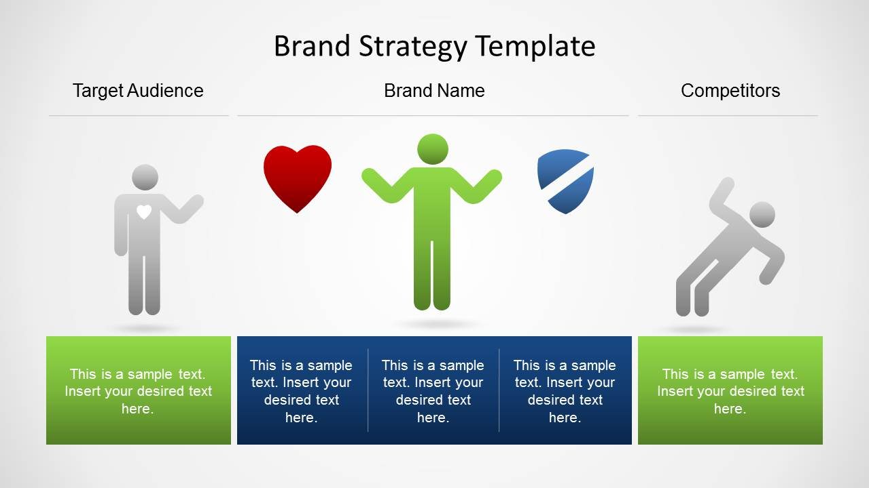


Brand name strategy
SLOGAN: You have question. We have HAKO.

Slide 12



Technological requirements
Adobe Creative Cloud
Visual Studio code
Azure Microsoft

Slide 13
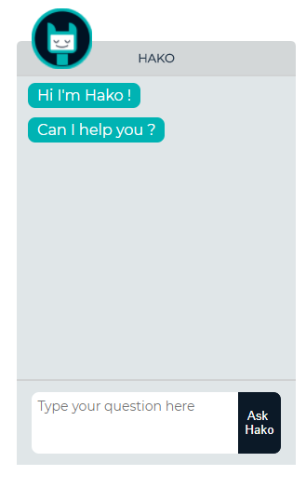
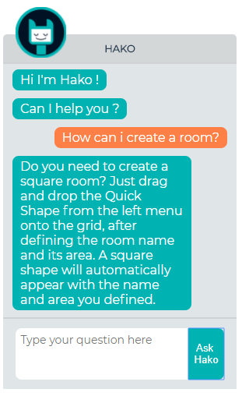
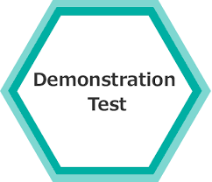

https://romantic-cori-654e48.netlify.com/

Slide 14
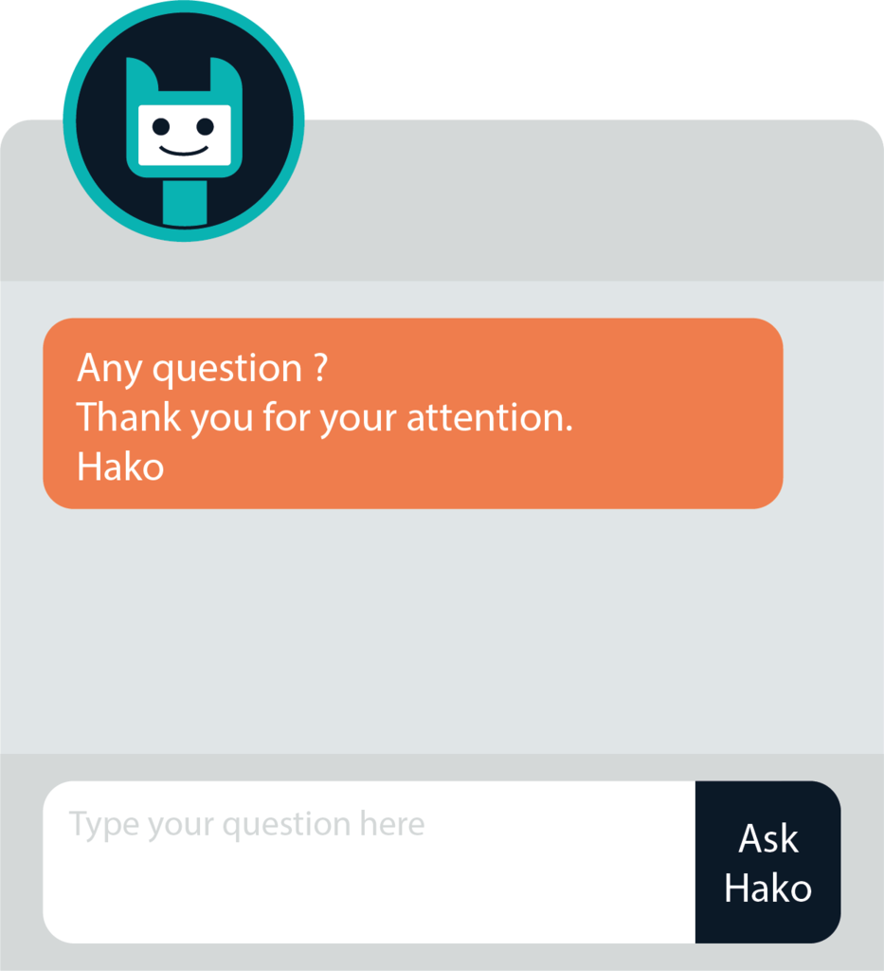

Slide 15
Subscription
Small 9€/Monthly | Professional 99 €/M | Business 199€/M
First user | PME client | Group client
50 FAQ | 150 FAQ | 300 FAQ
Chat direct | Chat direct | Chat direct
Unlimited leads | Unlimited leads | Unlimited leads
Tracebility | Tracebility | Tracebility

Slide 16
References
http://www.hakobio.com (Retrieved, 19.03.2019)
https://opusresearch.net/wordpress/pdfs/DMGuide_EnterpriseIA_Opus_KeyFindings_feb2017.pdf (Retrieved, 19.03.2019)
https://datanews.levif.be/ict/actualite/les-chatbots-deviennent-votre-interlocuteur/article-longread-699247.html (Retrieved, 20.03.2019)
https://rubygarage.org/blog/how-much-does-it-cost-to-build-a-chatbot (Retrieved, 21.3.2019)
https://www.adobe.com/be_fr/creativecloud/plans.html (Retrieved, 21.03.2019)
https://azure.microsoft.com/fr-fr/pricing/calculator/ (Retrieved, 21.03.2019)

